Slide 1



FinalProject_Nitin R Bankar
View in Power BI
Last data refresh:
9/22/2023 12:17:12 PM UTC
Downloaded at:
9/22/2023 12:19:27 PM UTC

Slide 2
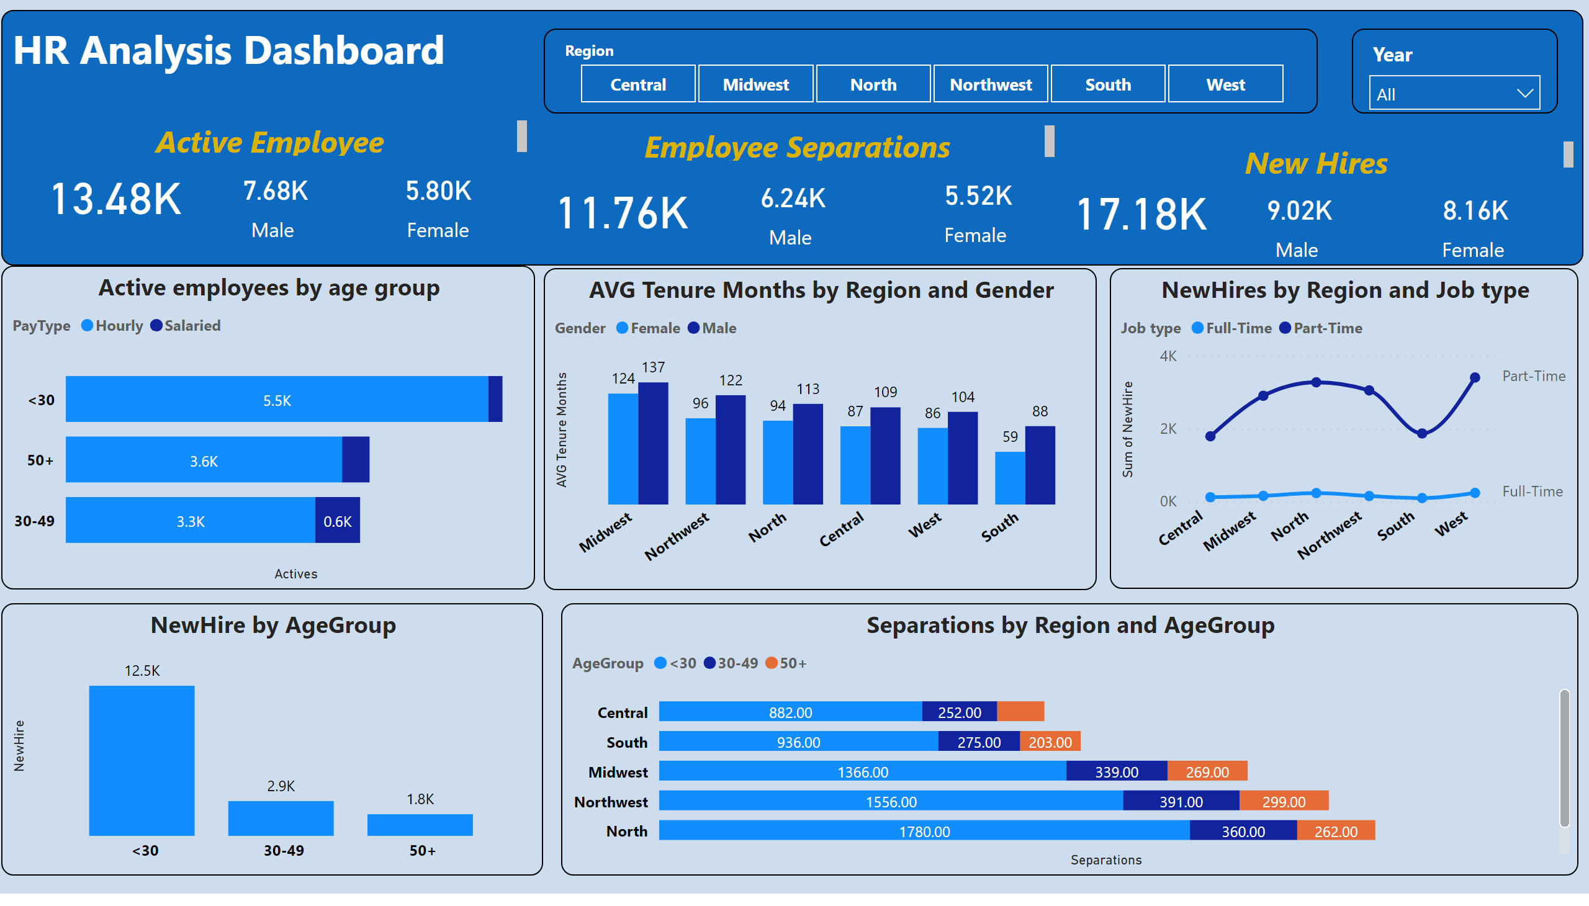
HR Anaylsis
Notes:
clusteredColumnChart
No alt text provided
Active employees by age group
No alt text provided
textbox
No alt text provided
card
No alt text provided
slicer
No alt text provided
card
No alt text provided
slicer
No alt text provided
card
No alt text provided
textbox
No alt text provided
textbox
No alt text provided
card
No alt text provided
card
No alt text provided
card
No alt text provided
textbox
No alt text provided
card
No alt text provided
card
No alt text provided
card
No alt text provided
NewHires by Region and Job type
No alt text provided
clusteredColumnChart
No alt text provided
barChart
No alt text provided

